Slide 1
Solving Problems by Searching

Slide 2
Chapter’s Outline
Problem Solving Agents
Well Defined Problems and Solutions
Example Problems
Searching for Solutions
Infrastructure of Search Algorithms
Performance Metric
Uninformed Search Strategies
Informed (Heuristic) Search Strategies
2

Slide 3
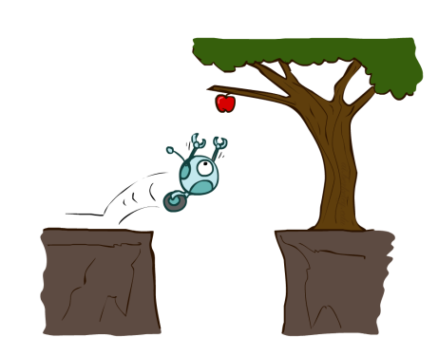
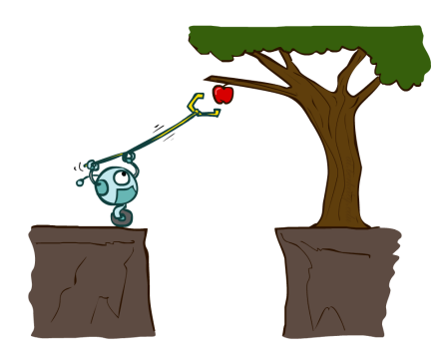
Types of agents
Scenario 1
Scenario 2

Slide 4
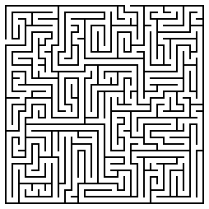
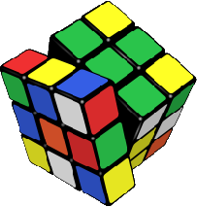
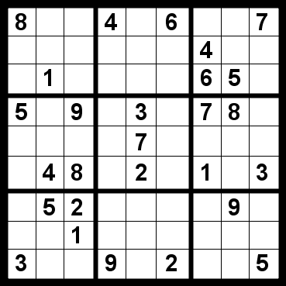
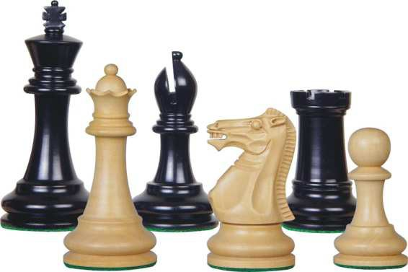
Initial Simplifying Assumptions
Environment is static
  no changes in environment while problem is being solved
Environment is observable
Environment and actions are discrete
  (typically assumed, but we will see some exceptions)
Environment is deterministic
Environment is known
4

Slide 5
Problem
A farmer wants to get his cabbage, goat, and wolf across a river. He has a boat that only holds two. He cannot leave the cabbage and goat alone or the goat and wolf alone. How many river crossings does he need?
- 4
- 5
- 6
- 7
- no solution

Slide 6
Solution
The wolf does not eat cabbage, so the crossing can start with the goat.
The man leaves the goat and returns, puts the cabbage in the boat and takes it across. On the other bank, he leaves the cabbage but takes the goat.
He leaves the goat on the first bank and takes the wolf across. He leaves the cabbage with the wolf and rows back alone.
He takes the goat across.

Slide 7
Problem
  Try to think about how you did it.
  Simulated the scenario mentally. Considered sending the farmer over with the goat.
  Observed the consequences. Checked if anything got eaten
  If nothing was eaten, proceeded with the next action
  If something got eaten, undid that move .Tried an alternative action
But the point is not for you to be able to solve this one problem manually.
To enable machines to solve problems systematically, a structured/systematic approach is required that considers all possibilities.
Search problems define these possibilities, and search algorithms are designed to systematically explore them to find solutions.

Slide 8

Search
We will consider the problem of designing goal- based agents in fully observable, deterministic, discrete, known environments
Start state
Goal state

Slide 9
Search
We will consider the problem of designing goal-based agents in fully observable, deterministic, discrete, known environments
  The agent must find a sequence of actions that reaches the goal.
  The performance measure is defined by
Reaching the goal and
How “expensive” the path to the goal is
– We are focused on the process of finding the solution; while executing the solution, we assume that the agent can safely ignore its percepts.

Slide 10

Search problem components
Initial state
Actions
Transition model
  What state results from performing a given action in a given state?
Goal state
Path cost
  Incurred when moving from one state to another after applying an action
Initial state
Goal state
The optimal solution is the sequence of actions that gives the
lowest path cost for reaching the goal

Slide 11
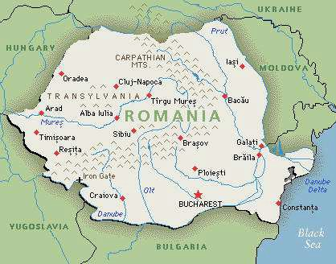
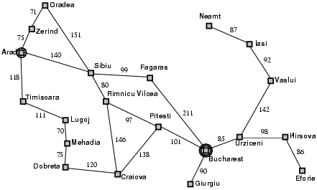
Example: Romania
On vacation in Romania; currently in Arad
Flight leaves tomorrow from Bucharest
  Initial state
    Arad
  Actions
    Go from one city to another
  Transition model
    If you go from city A to city B, you end up in city B
  Goal test
    Is state == Bucharest
  Path cost
    Sum of edge costs (total distance traveled)

Slide 12

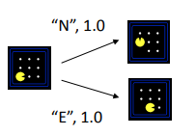
Problem-Solving Agents
Intelligent agents can solve problems by searching a state- space
State-space Model
  the agent’s model of the world
  usually a set of discrete states
  e.g., in driving, the states in the model could be towns/cities
Operators (actions, successor function)
  operators are legal actions which the agent can take to move from one state to another
Goal State(s)
  a goal is defined as a desirable state for an agent
  there may be many states which satisfy the goal test
    e.g., drive to a town with a ski-resort
  or just one state which satisfies the goal
    e.g., drive to Karachi

Slide 13
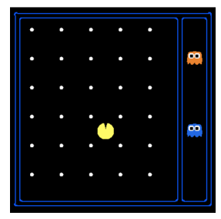
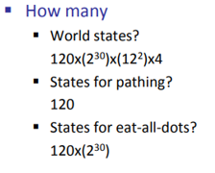

State space
The initial state, actions, and transition model define the state space of the problem.
  The set of all states reachable from initial state by any sequence of actions.
  Distinguish between world state and Search state
  The world state includes every last detail of the environment.
Notes:
So, the total number of possible world states is:
2^4=2×2×2×2=16
This means there are 16 different possible configurations or states that the game world can be in when considering 4 locations. Each configuration represents a unique combination of which locations are occupied and which are not.

Slide 14
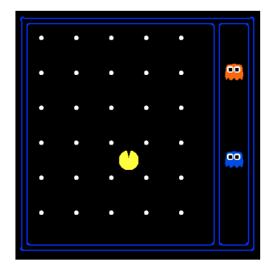
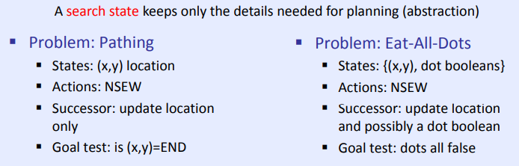
State space
Consider a variation of the game in which the maze contains only Pacman and food pellets.
We can pose two distinct search problems in this scenario: pathing and eat-all-dots
For pathing, states contain less information than states for eat-all-dots.
For eat-all-dots we must maintain an array of booleans corresponding to each food pellet and whether or not it’s been eaten in the given state
Notes:
So, the total number of possible world states is:
2^4=2×2×2×2=16
This means there are 16 different possible configurations or states that the game world can be in when considering 4 locations. Each configuration represents a unique combination of which locations are occupied and which are not.

Slide 15
Abstraction
Definition:
Process of removing irrelevant detail to create an abstract representation: ``high-level”, ignores irrelevant details
Navigation Example: how do we define states and operators?
  First step is to abstract “the big picture”
    i.e., solve a map problem
    nodes = cities, links = freeways/roads (a high-level description)
    this description is an abstraction of the real problem
  Can later worry about details like scenery, refueling, etc
Abstraction is critical for automated problem solving
  must create an approximate, simplified, model of the world for the computer to deal with: real-world is too detailed to model exactly
  good abstractions retain all important details

Slide 16
State-Space Problem Formulation
A problem is defined by four items:
    Initial state e.g., "at Arad“
    Actions or successor function
      S(x) = set of action–state pairs
      e.g., S(Arad) = {<Arad , Zerind>,<Arad, Timisoara>, … }
      Function S(x) takes a state x as input and returns a set of action-state pairs
    3. Goal test (or set of goal states)
      e.g., x = "at Bucharest”, Checkmate(x)
    Transition model: Result(s,a)
      how the state changes when an action is taken. The result(s,a) represents the state that results from taking action a in state s.
    Path cost (additive)
      e.g., sum of distances, number of actions executed, etc.
      c(x,a,y) is the step cost, assumed to be ≥ 0
    A solution is a sequence of actions leading from the initial state to a goal state

Slide 17
Example: Traveling Salesperson Problem
Find the shortest tour that visits all cities without visiting any city twice and return to starting point.
State: sequence of cities visited
S₀ = A
C
B
A
D
F
E
G = a complete tour

Slide 18

Example: Vacuum world
States
  Agent location and dirt location
  How many possible states?
  What if there are n possible locations?
    The size of the state space grows exponentially with the “size” of the world!
Actions
  Left, right, suck
Transition model
Goal states
Action cost:

Slide 19
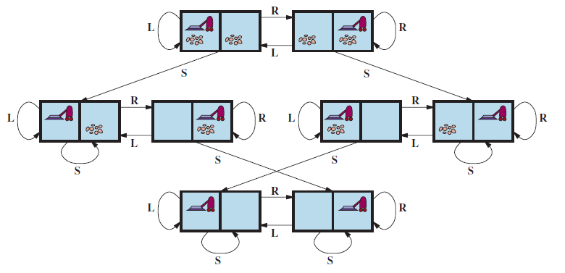
Vacuum world state space graph

Slide 20
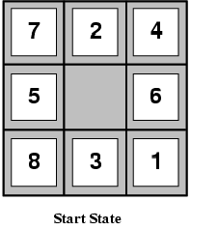
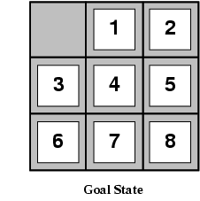
Example: The 8-puzzle
States
  Locations of tiles
• 8-puzzle: 181,440 states (9!/2)
    15-puzzle: ~10 trillion states
    24-puzzle: ~10²⁵ states
Actions
  Move blank left, right, up, down
Path cost
  1 per move

Slide 21
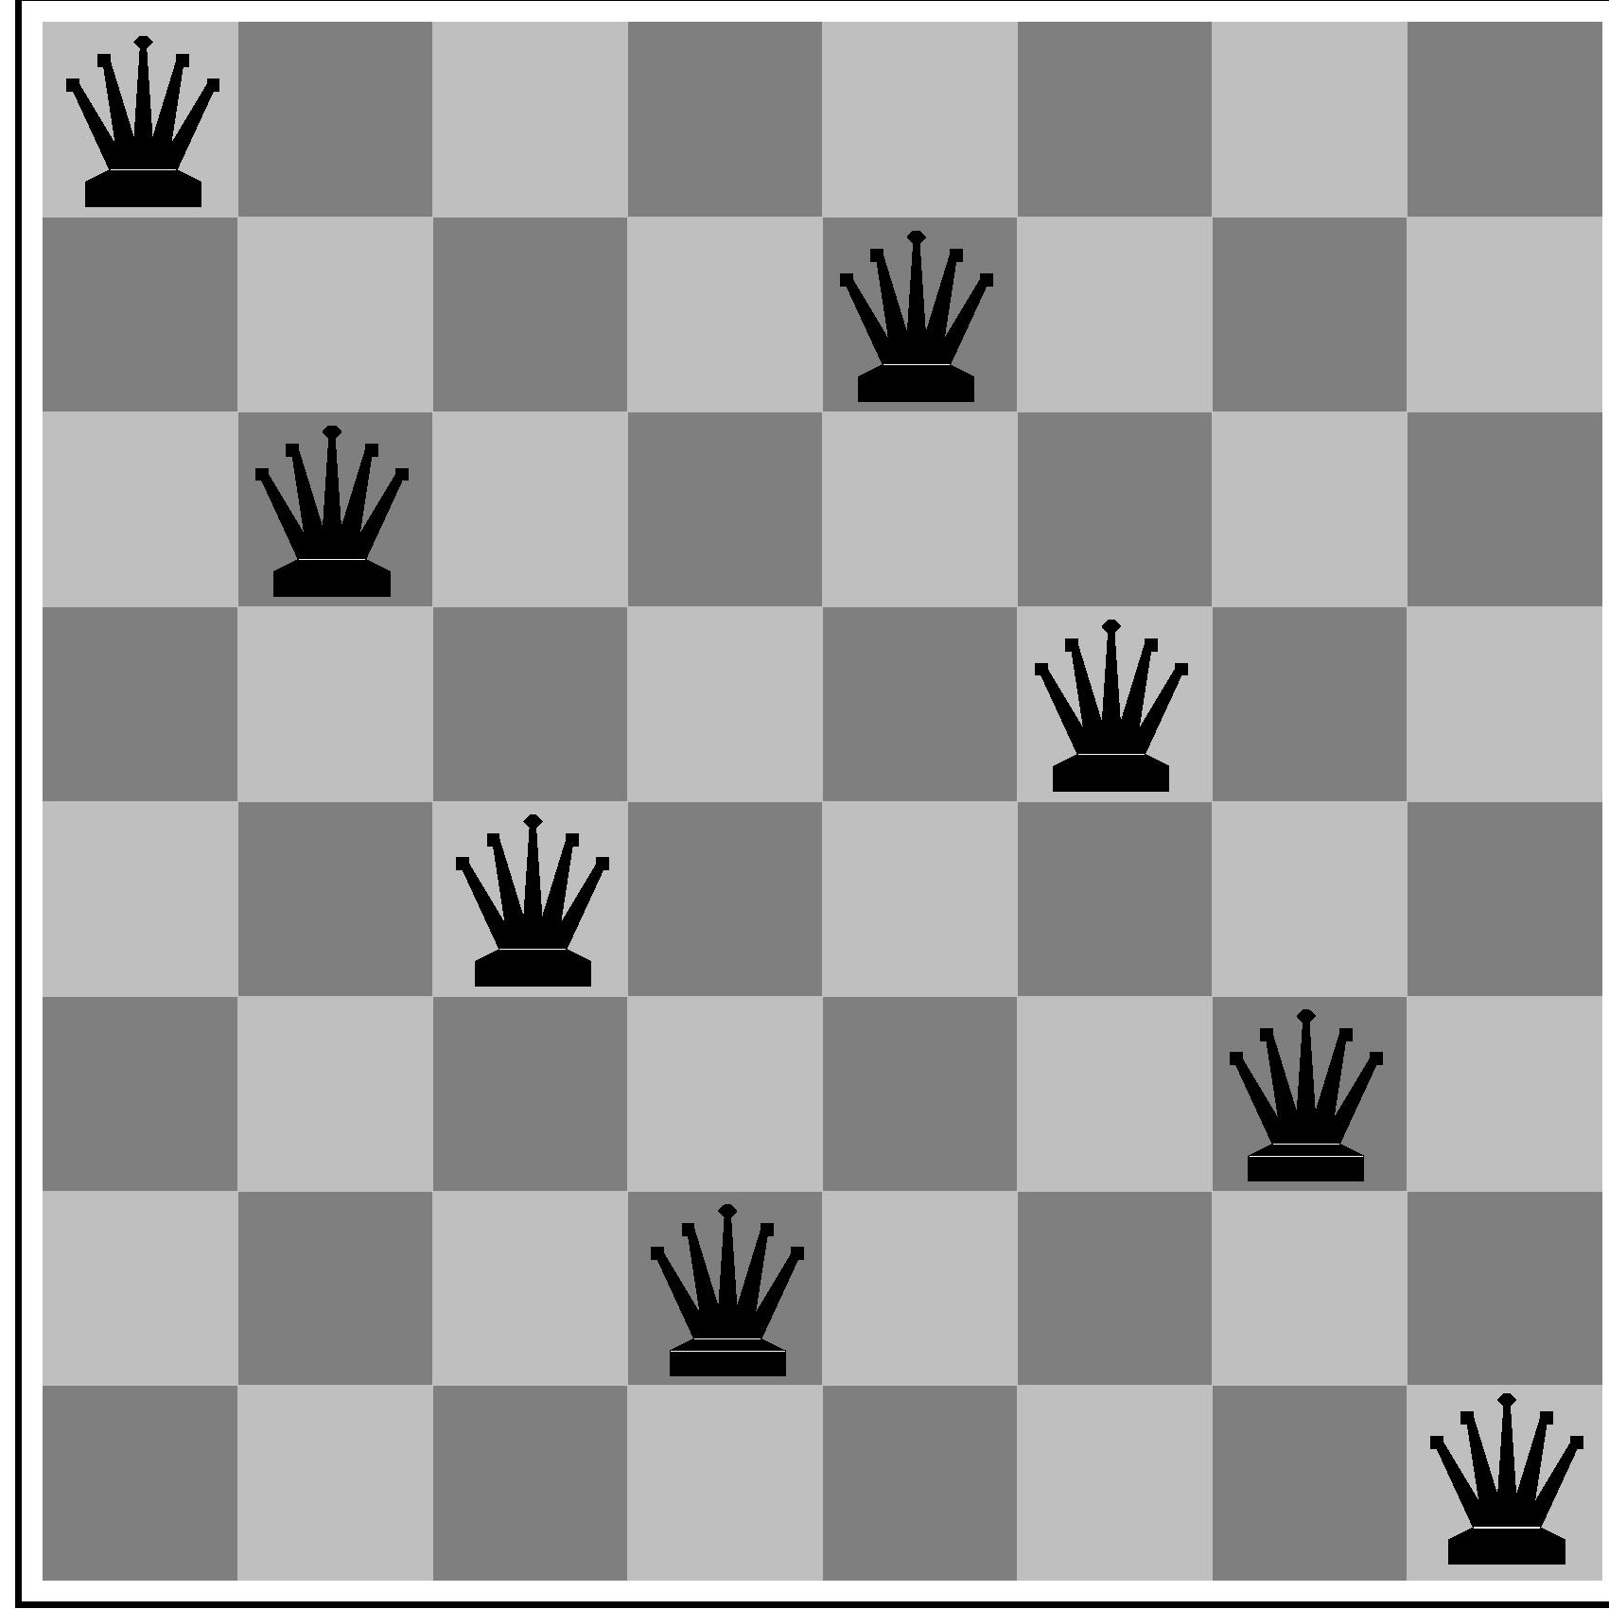
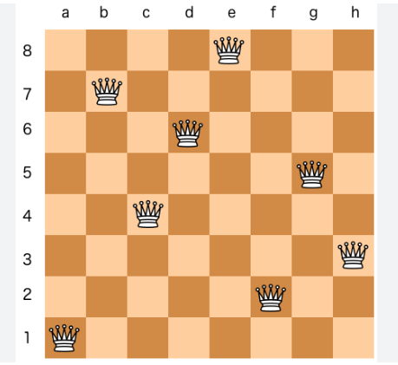
State-Space problem formulation
states?
  -- arrangements of n<=8 queens, such that no queen attacks any other.
initial state? no queens on the board
actions?
  -add queen to any empty square
  -or add queen to leftmost empty square such that it is not attacked by other queens.
goal test? 8 queens on the board, none attacked.
path cost? 1 per move

Slide 22
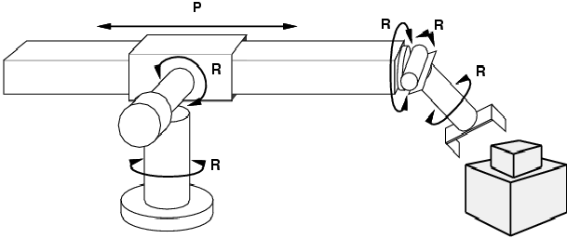
Example: Robot motion planning
States
  Real-valued joint parameters (angles, displacements)
Actions
  Continuous motions of robot joints
Goal state
  Configuration in which object is grasped
Path cost
  Time to execute, smoothness of path, etc.

Slide 23
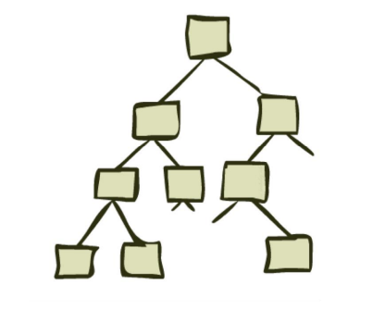
Search problem solution
State Space Graphs and Search Trees

Slide 24
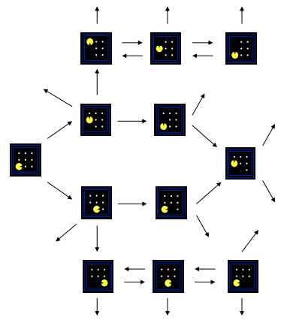
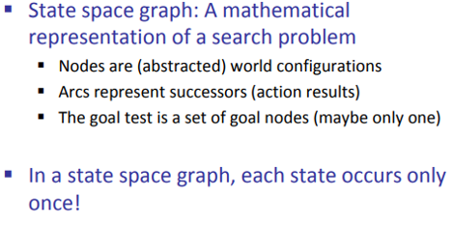
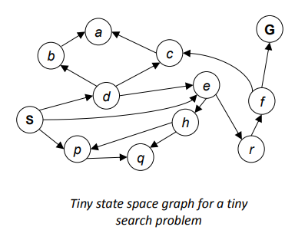
State space
  Can be represented as a directed graph where the nodes are states and links between nodes are actions
state space graphs are much too large to store in memory (a simple Pacman example from above has ≈ 10¹³ possible states

Slide 25

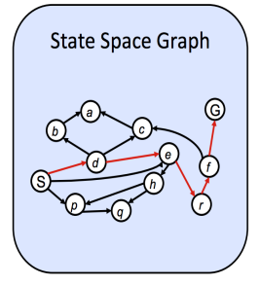
State space graphs can be enormous, even for simple problems.
Challenge: Performing useful computations when the state space is too large to fit in memory.
Solution: Compute children of the current state on-demand using methods like getNextState, getAction, and getActionCost.
Only store the states being worked with immediately, rather than the entire graph.
Search problems are typically solved using search trees.
Search trees store only a few nodes at a time, replacing them with their children iteratively.
The process continues until a goal state is reached.
Possible solution
(S → d → e → r → f → G)

Slide 26
Search: Basic idea
Let’s begin at the start state and expand it by making a list of all possible successor states.
Maintain a frontier ( fringe ) or a list of unexpanded states
At each step, pick a state from the frontier to expand
Keep going until you reach a goal state
Try to expand as few states as possible

Slide 27
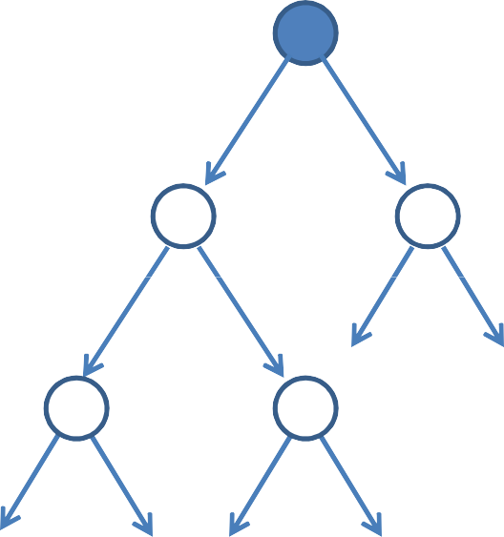
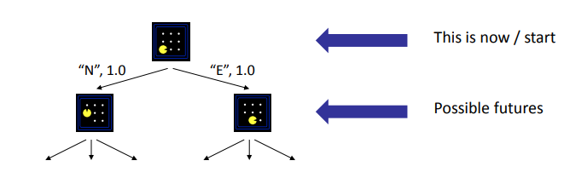
Search tree
Starting state
“What if” tree of sequences of actions and outcomes.
The root node corresponds to the starting state
The children of a node correspond to the successor states of that node’s state
A path through the tree corresponds to a sequence of actions
– A solution is a path ending in the goal state
Action
Successor state
…
… … …
Goal state

Slide 28
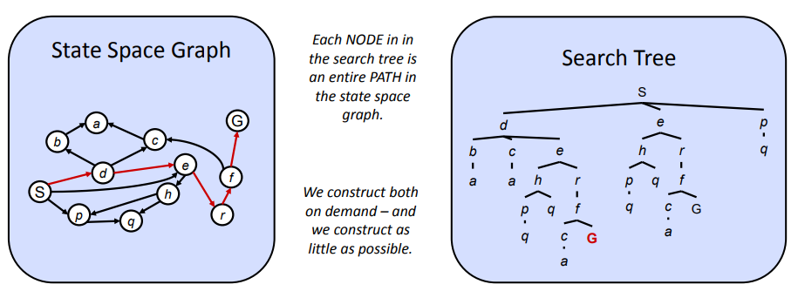
State Space Graphs vs. Search Trees
The state space graph is a more comprehensive representation of the problem's state transitions, while the search tree is a tool used by algorithms to explore those states to find a solution.

Slide 29
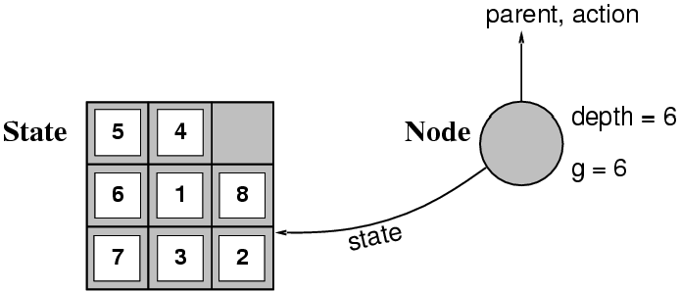
States versus Nodes
A state is a (representation of) a physical configuration
A node is a data structure constituting part of a search tree contains info such as: state, parent node, action, path cost g(x), depth

Slide 30
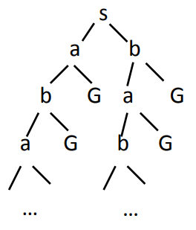
State Spaces versus Search Trees
State Space
  Set of valid states for a problem
  Linked by operators ( Transportation connection between cities)
  e.g., 20 valid states (cities) in the Romanian travel problem
Search Tree
  Root node = initial state
  Child nodes = states that can be visited from parent
  Note that the depth of the tree can be infinite
    E.g., via repeated states
  Partial search tree
    Portion of tree that has been expanded so far
  Fringe
    Leaves of partial search tree, candidates for expansion
Search trees = data structure to search state-space
Size/Depth =??

Slide 31
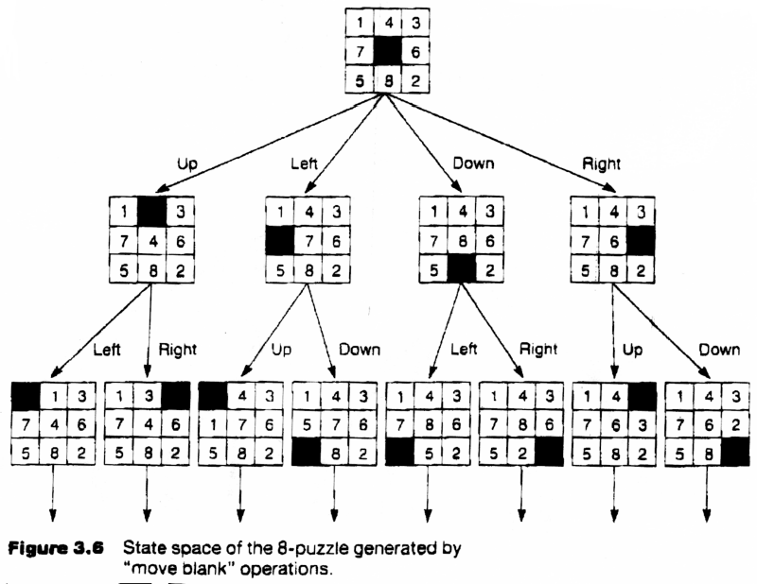
Search Tree for the 8 puzzle problem

Slide 32
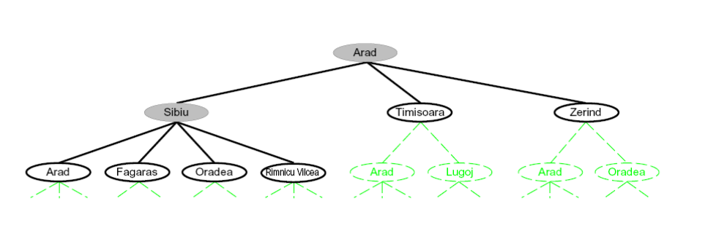
Romania Search Tree

Slide 33
Search Tree:
  This is a data structure used to represent the possible solutions to a problem.
  It's a tree-like structure where each node represents a state in the problem, and edges connect states reachable by applying specific actions
Tree Search:
  This is a technique used to explore possibilities within a search tree to reach the goal.
  It systematically traverses the tree, considering different paths by choosing nodes to expand and visit next.
a search tree holds the information, while tree search is the strategy to navigate through that information to find the desired solution. They are two parts of the same problem-solving process.

Slide 34
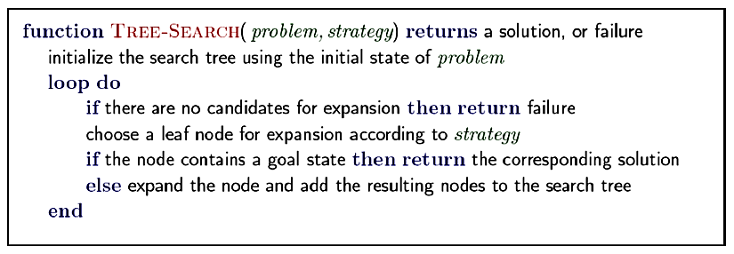
Tree Search Algorithm Outline
Important Ideas:
Fringe: This is like the list of paths you haven't explored yet. Initially, it contains only the starting point of the maze.
Expansion: As you move through the maze, you "expand" the fringe by adding new paths. if you're standing at a three-way junction, expanding involves adding three new paths to the fringe, each corresponding to taking one of the turns.
Exploration Strategy: This governs how you decide which path to explore next.
Main question: which fringe nodes to explore?

Slide 35
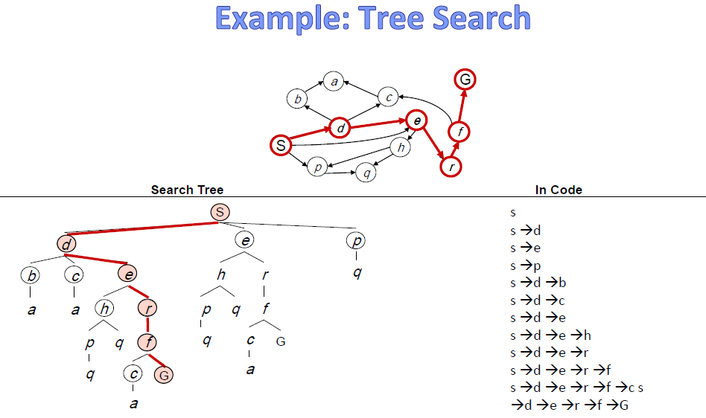
Concept of Fringe

Slide 36
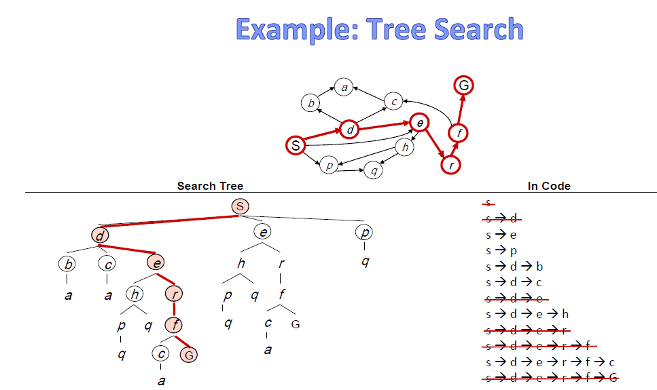

Slide 37
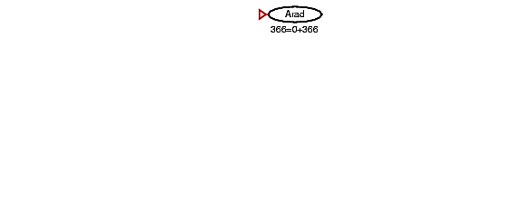
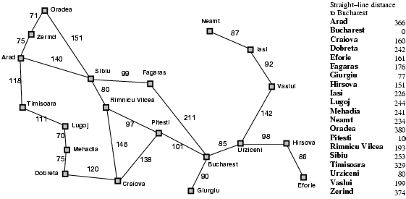
Tree search example
Start: Arad Goal: Bucharest

Slide 38
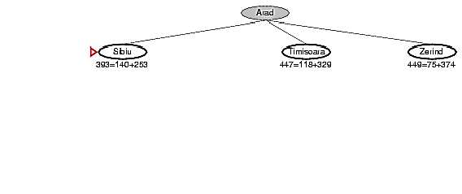
Tree search example
Start: Arad Goal: Bucharest

Slide 39
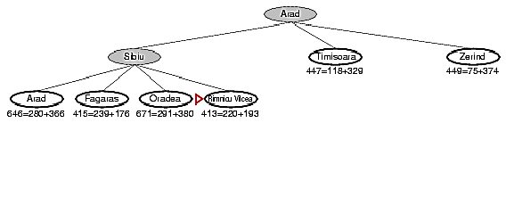

Tree search example
Start: Arad Goal: Bucharest

Slide 40
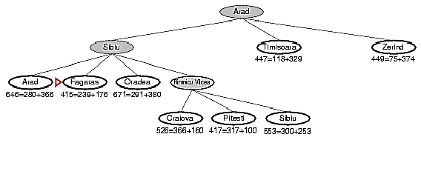

Tree search example
Start: Arad Goal: Bucharest

Slide 41
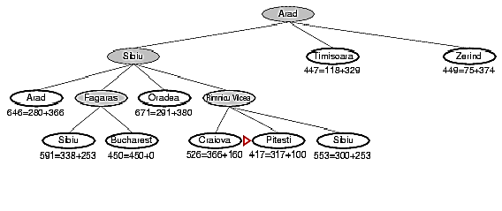
Tree search example
Start: Arad Goal: Bucharest

Slide 42
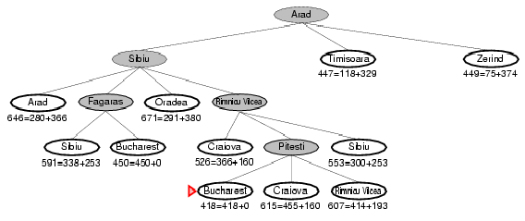
Tree search example
Start: Arad Goal: Bucharest

Slide 43
Tree search example
Start: Arad Goal: Bucharest

Slide 44
Handling repeated states
Initialize the frontier/fringe using the starting state
While the frontier is not empty
  Choose a frontier/fringe node according to search strategy and take it off the frontier/fringe
  If the node contains the goal state, return solution
  Else expand the node and add its children to the frontier
To handle repeated states:
  Every time you expand a node, add that state to the explored set; do not put explored states on the frontier again.
  Every time you add a node to the frontier, check whether it already exists in the frontier with a higher path cost, and if yes, replace that node with the new one.

Slide 45
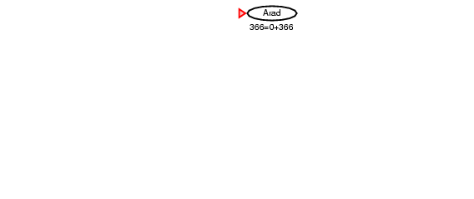
Search without repeated states
Start: Arad Goal: Bucharest

Slide 46

Search without repeated states
Start: Arad Goal: Bucharest

Slide 47
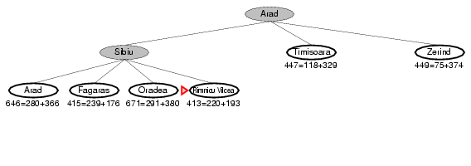
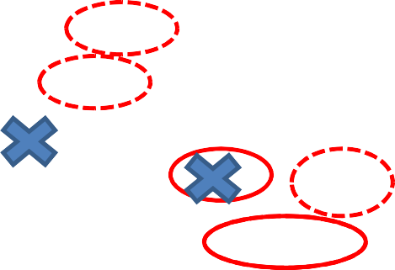
Search without repeated states
Start: Arad Goal: Bucharest

Slide 48
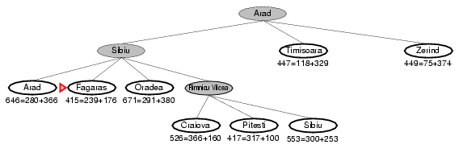
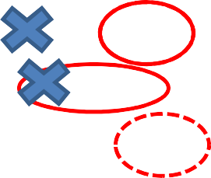
Search without repeated states
Start: Arad Goal: Bucharest

Slide 49
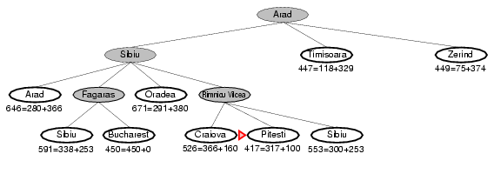
Search without repeated states
Start: Arad Goal: Bucharest

Slide 50
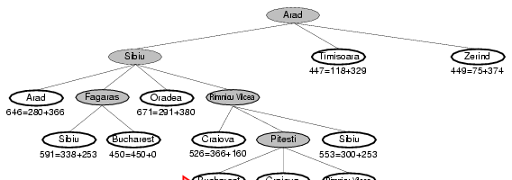
Search without repeated states
Start: Arad Goal: Bucharest

Slide 51
Search without repeated states
Start: Arad Goal: Bucharest

Slide 52
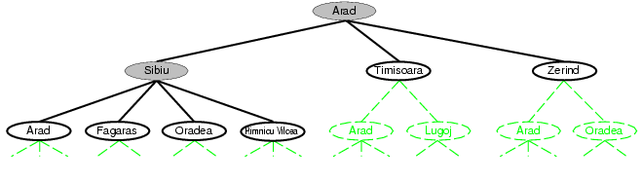
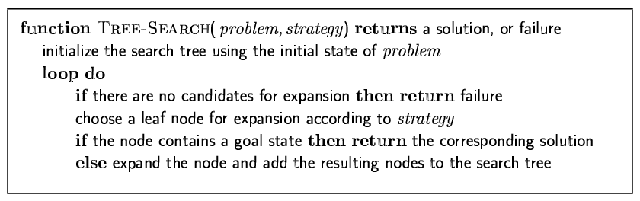
Tree Search Algorithm
44

Slide 53
Tree Search Algorithm
This “strategy” is what differentiates different search algorithms

Slide 54
Search Strategies
A search strategy is defined by picking the order of node expansion e.g. Breadth First Search
Strategies are evaluated along the following dimensions:
Completeness
  Guarantees finding a solution whenever one exists
Time Complexity
  How long (worst or average case) does it take to find a solution? Usually measured in terms of the number of nodes expanded
Space Complexity
  How much space is used by the algorithm? Usually measured in terms of the maximum size that the “OPEN" list becomes during the search
Optimality/Admissibility
  If a solution is found, is it guaranteed to be an optimal one? For example, is it the one with minimum cost?

Slide 55
The End
48

